Slide 1

Data Analytics Bootcamp
Project 1: Data thieves
‘KBK Travel Search Engine’
Kamila | Bruno | Kaspar

Slide 2



MOTIVATION
The majority of travel search engines in the market were created to attend only one task and are not so good in comparing destinations based on multiples variables
GOAL
Create a customized search engine for travel that compares destinations based on flights, hotels and weather conditions
1. A couple will be finishing their Ironhack bootcamp and want to take some time off at the beach
2. The are deciding among the following destinations:
Buenos Aires Cancun Rio de Janeiro
3. Dates available to travel:
21/12/19 to 27/12/19 18/01/20 to 24/01/20 22/02/20 to 28/02/20
4. Low budget profile
4.1. Cheapest flight regardless of the total duration of the flight
4.2. Cheapest 4 star hotel room
5. They intend to travel for 7 days

Slide 3




STEP 1:
Project planning & defining roles/responsibilities
STEP 2:
Choose the best data source and scraping methodology
APIs (Application Programming Interface)
FLIGHTS
(SKYSCANNER)
HOTEL
(KAYAK)
WEATHER
(DARSKY)
STEP 3:
Code and make it work!
FLIGHTS
(SKYSCANNER)
HOTEL
(KAYAK)
WEATHER
(DARSKY)
Pandas
Extract flight details, prices, providers
Collate data from API
Read the API documentation
Identify the best price quality hotel for each location and departure date
1 DF for each member
Those DFs were merged by the end of the project
Sort
Save the cheapest flight
Prototype code
Compile the data into one series
Protoytpe function
Loop and Merge
Repeat for all the query options
Create a customised executive summary based on the total price and weather condition
Final function

Slide 4
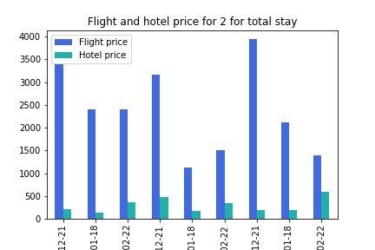
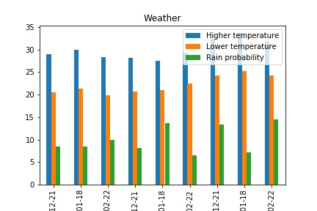
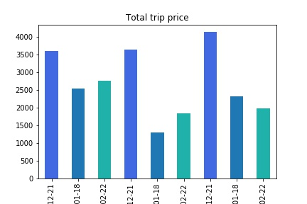
Detailed Report
Buenos Aires
Cancun
Rio de Janeiro
Buenos Aires
Cancun
Rio de Janeiro
Buenos Aires
Cancun
Rio de Janeiro

Slide 5



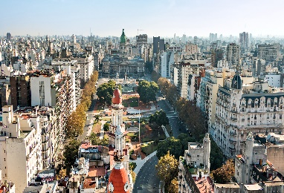
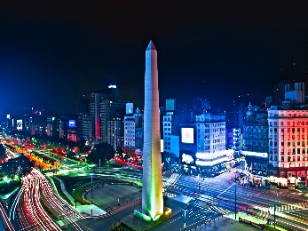
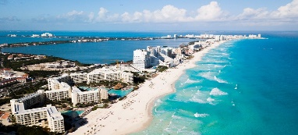
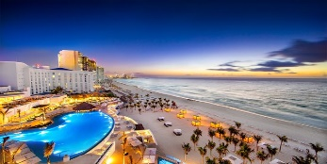
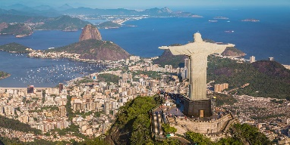
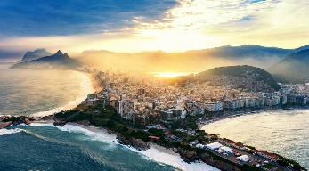
Executive Summary
 | December |  | January |  | February
 | Total Price | Weather | Total Price | Weather | Total Price | Weather
Buenos Aires | €3598 |  | €3643 |  | €4143
Cancun | €2536 |  | €1307 |  | €2318
Rio de Janeiro | €2768 |  | €1837 |  | €1982
Min: 20c
Max: 29c
Min: 21c
Max: 30c
Min: 20c
Max: 28c
Min: 21c
Max: 28c
Min: 21c
Max: 27c
Min: 22c
Max: 29c
Min: 24c
Max: 32c
Min: 25c
Max: 34c
Min: 24c
Max: 32c

Slide 6


ACCOMPLISHMENTS
NEXT STEPS
Great brainstorming sessions
Task division
Communication and support
Problem solving
Goals Achievement
Application of the skills learnt in the last weeks
Create a tool that takes the parameters and give combined and clean data frame as well as descriptive plots
Apply this methodology for all destinations in the world
Supplement additional information from different sources (e.g. restaurants, museums, pubs, breweries, sceneries)
Set up a webpage
Create an app for our KBK customers

Slide 7
Thank you!

